Slide 1
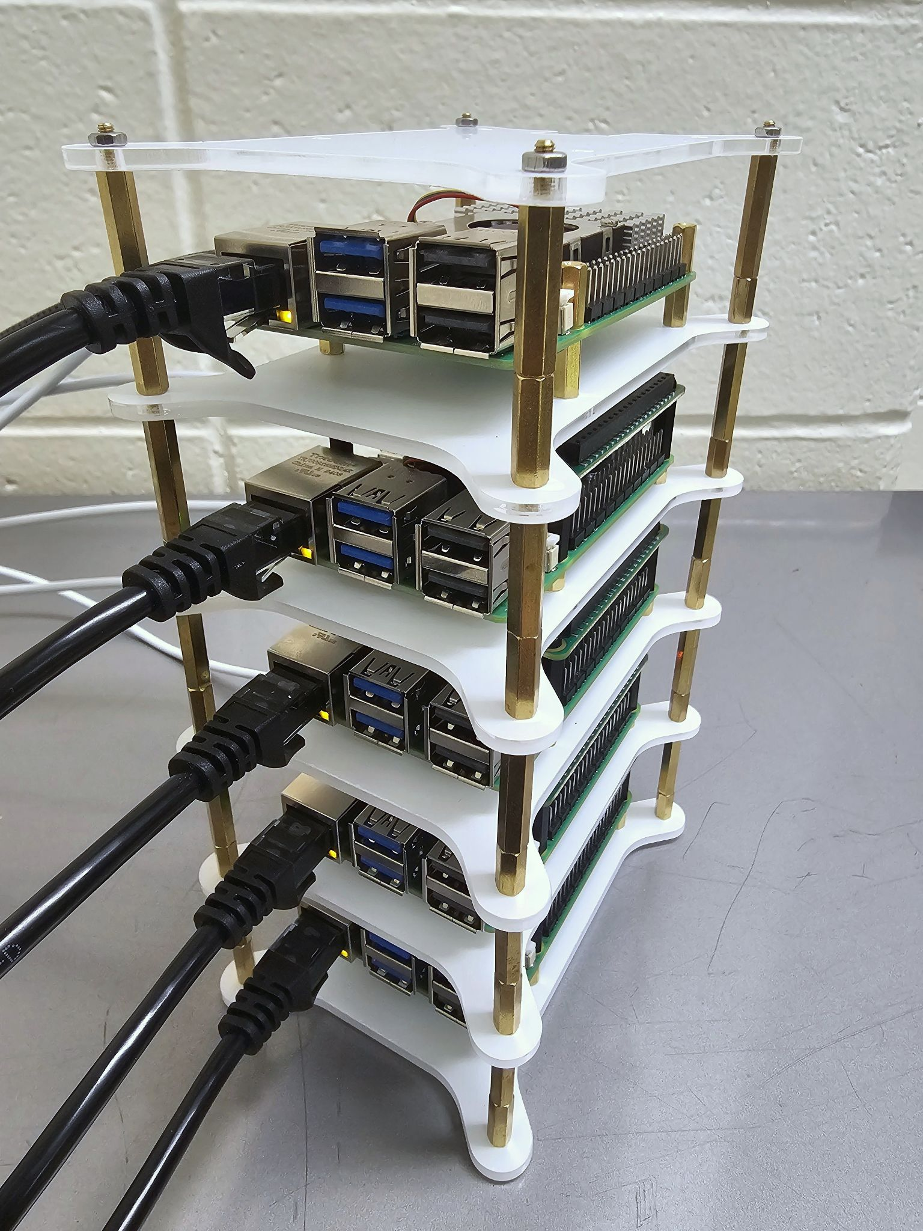
ClusterGit Project Proposal
Team #12

Slide 2
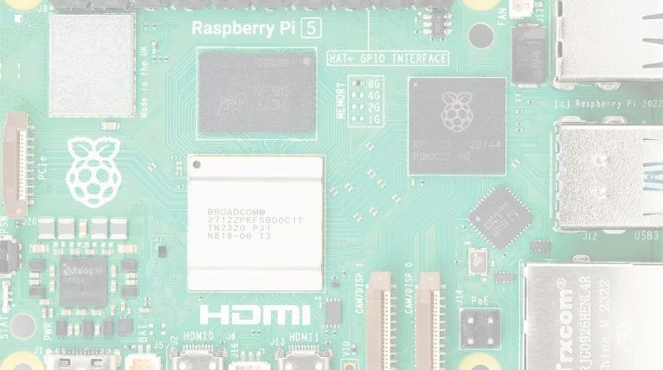

Team #12 Profile
Prof. Johns: Sponsor | Lecturer at PFW for Dept CS | HCI | Game Dev
Lauren: Team Lead | Tattoo Artist ⇒ Software Engineer Intern | 4+1 Student | Interested in ML & Embedded Devices
Conner: Python | Distributed Systems | ML
Sasha: Docker | Self-hosting | Unix servers | Shell scripting
Sean: 4+1 | Embedded Systems | Networking
Brandon: Cybersecurity | Linux | Violin

Slide 3


Problem Statement
Goal: Build a self-hosted, low-cost (both in terms of software and hardware) submission system on a Raspberry Pi cluster that supports very large, encrypted student projects
Large file storage is not natively offered by tools like Github. This creates a problem when using these platforms for version control of projects that have larger file sizes.
Notes:
SASHA

Slide 4
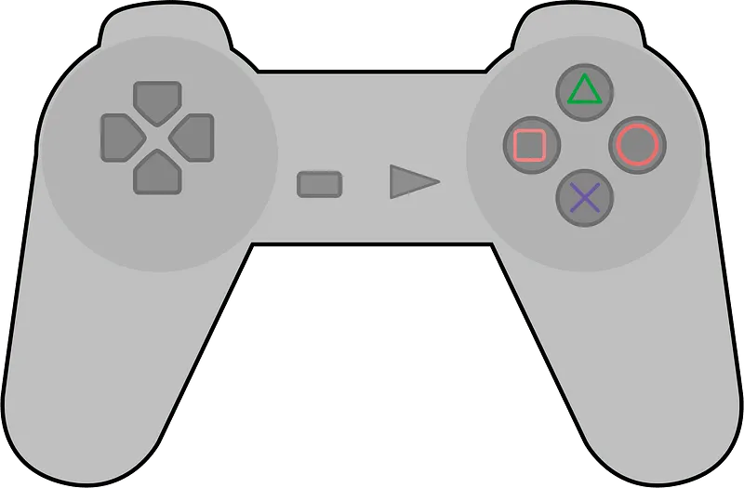
Case Study
Game Design Course Case Study
Large File Sizes
2GBs/assignment, 45 students/semester
Native git handles large files inefficiently.
Presence of Encrypted Files
Problems with industry standard repo management platforms
Small file size
10 GB limit on GitHub; 100 MB limit per files
No support for file encryption
Notes:
SASHA

Slide 5

Requirements with Deliverables

Slide 6
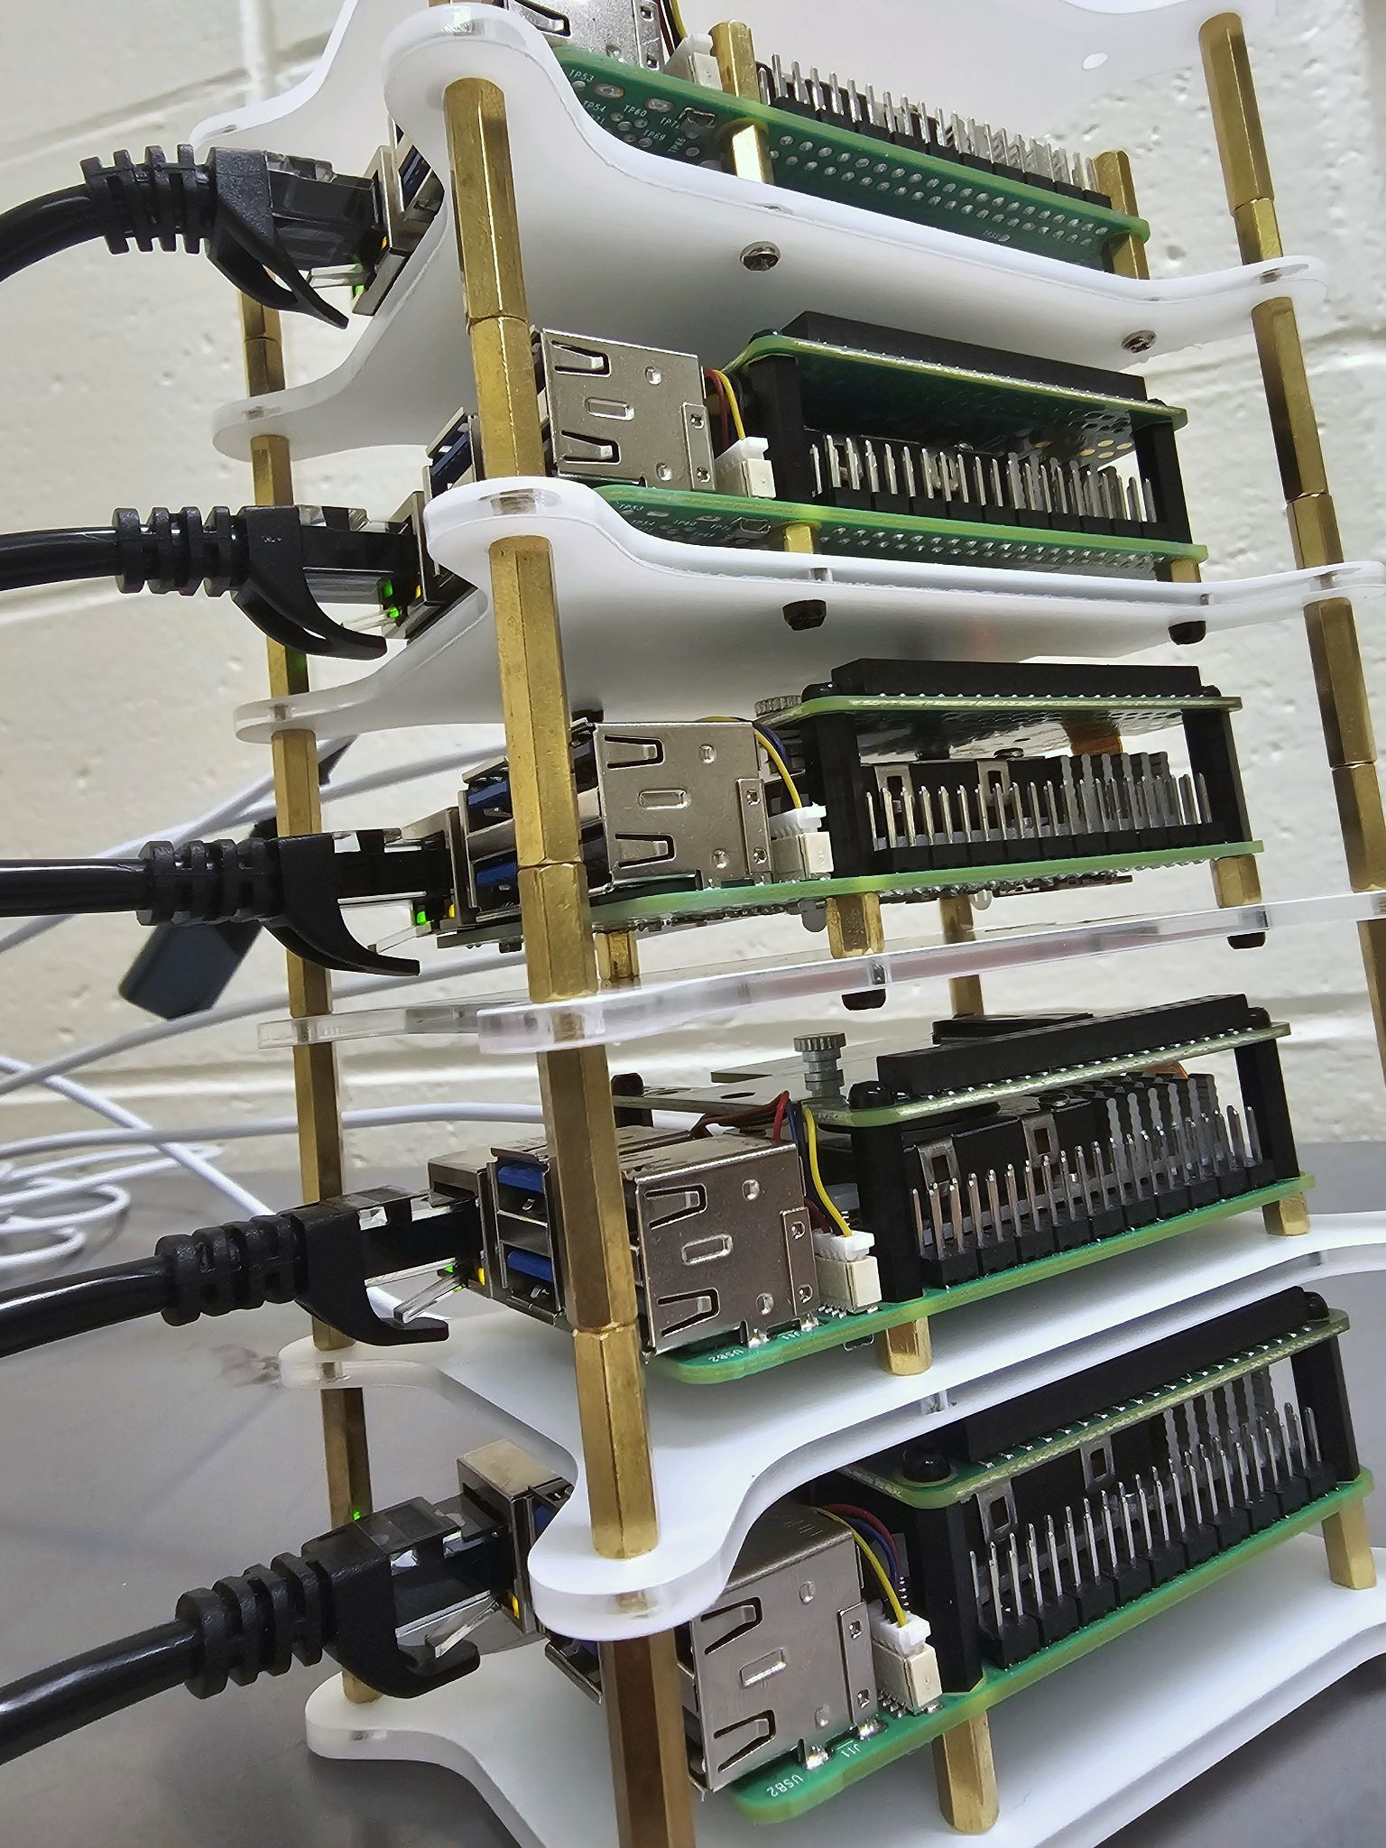
Semester One: Get the System to Work
Cluster Infrastructure
Pis prepped with Ubuntu server, networking, and SSH remote access
K3s installed, nodes joined into cluster
Containerization & Storage
Test workloads deployed with K3s orchestration
Longhorn file replication confirmed across nodes

Slide 7
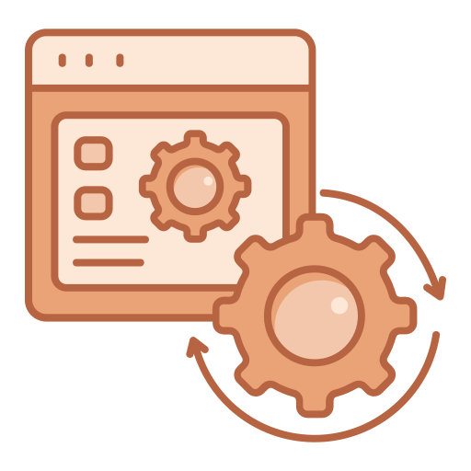
Semester One: Get the System to Work
Git Workflow
Git-annex layered with Git for large, encrypted file support
CLI commands verified: upload & download
Validation
4–8 GB Unity project upload simulated
Storage usage and performance measured
Verified: containerized, orchestrated, encrypted, replicated, retrievable

Slide 8

Semester Two: Application & Optimization
Encryption and Secure Transfer
File encryption at rest
Encryption for files in transit
User Auth and Access Control
Login system with user authentication
Users and access control, who can push, pull, and delete
Developing a User Interface
Creation of UI with honors student
Acquire a domain name for online access

Slide 9

Semester Two: Application & Optimization
4. Testing and User Feedback
4.1 Test user interface and eliminate potential errors
4.2 Get user feedback from both students and instructors
4.3 Revise interface based on user feedback
4.4 Repeat until product is ready for deployment

Slide 10


Stretch Goals
3D-printed frame for Pi cluster + local intranet
Virtual IDE for distributed development on low-cost devices
Secure access, credentials, and document integrity
Long-term maintainability with QA and NAS support
Auto-healing: nodes recover if one fails
Notes:
Sean the other goat, wightleight NAS as stretch goal Specific terminology of “multiple

Slide 11

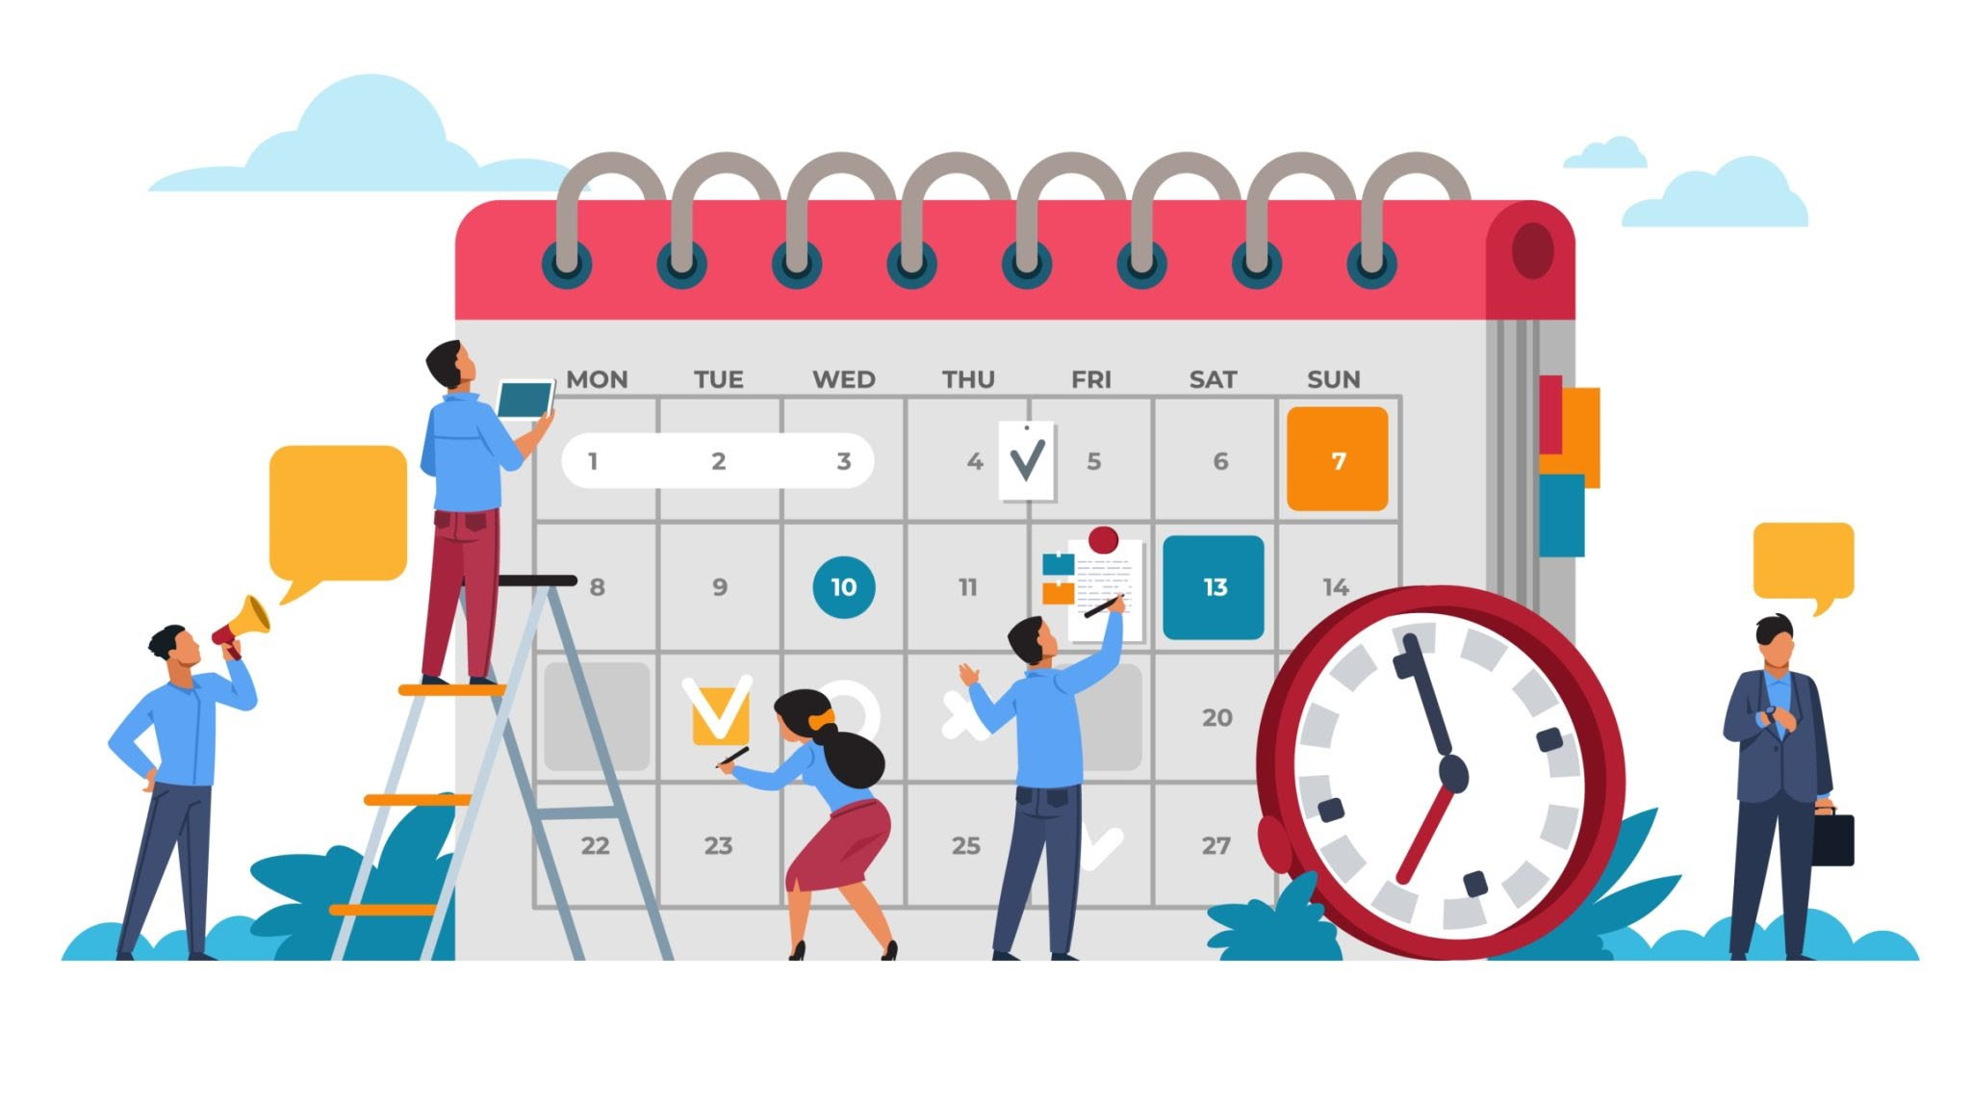
Risks/Challenges
Challenge: Varied backgrounds in technologies
Solution - Structured methods of sharing information
Challenge: Scheduling & Lab Access
Solution - Consistent meeting times
Challenge: Storage Bottleneck
Solution - External storage: NAS
Notes:
Conner the goat: scheduling and lab access - physical meeting Problem: Tech Integration // Tech layering | 2 m-hats potential 6TB storage needed (git-annex for chunking, git-crypt or Longhorn for encryption, k3s for org and orch, metalLB for load balancing, supabase for database and user auth) discord, github, shared google drive folder

Slide 12
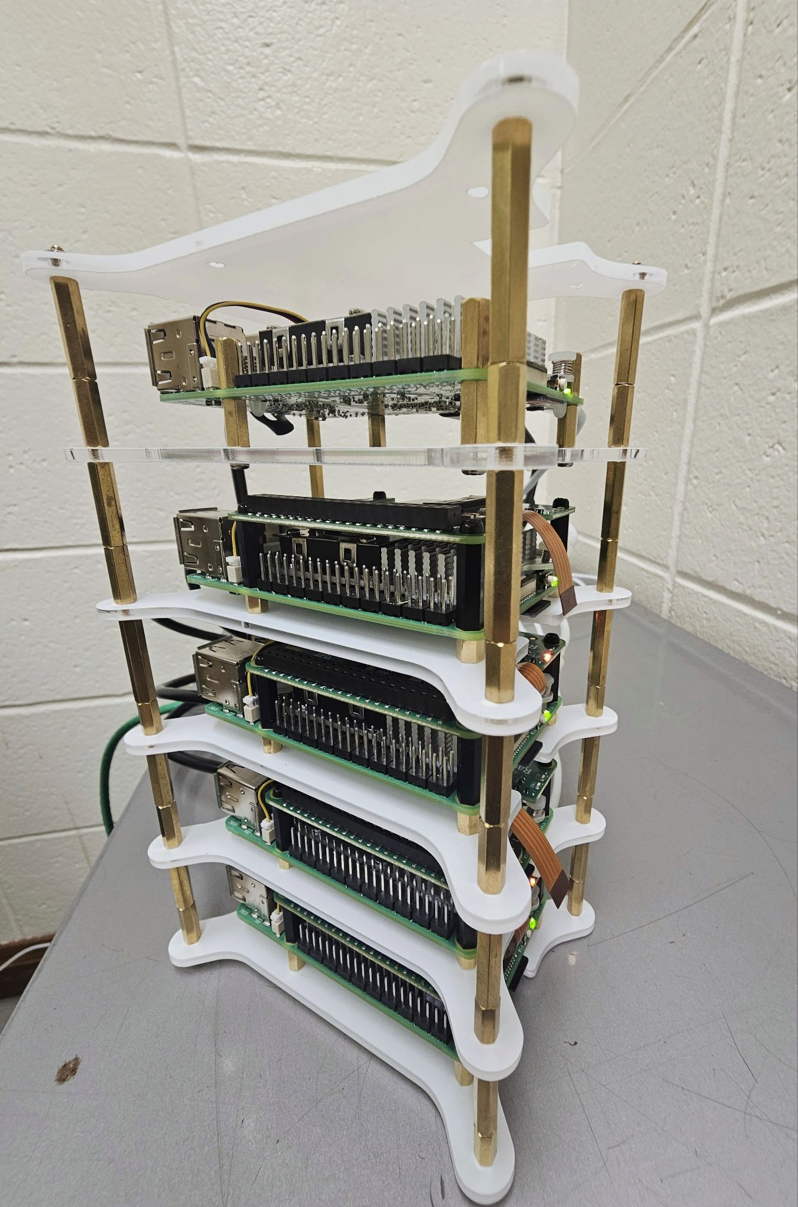



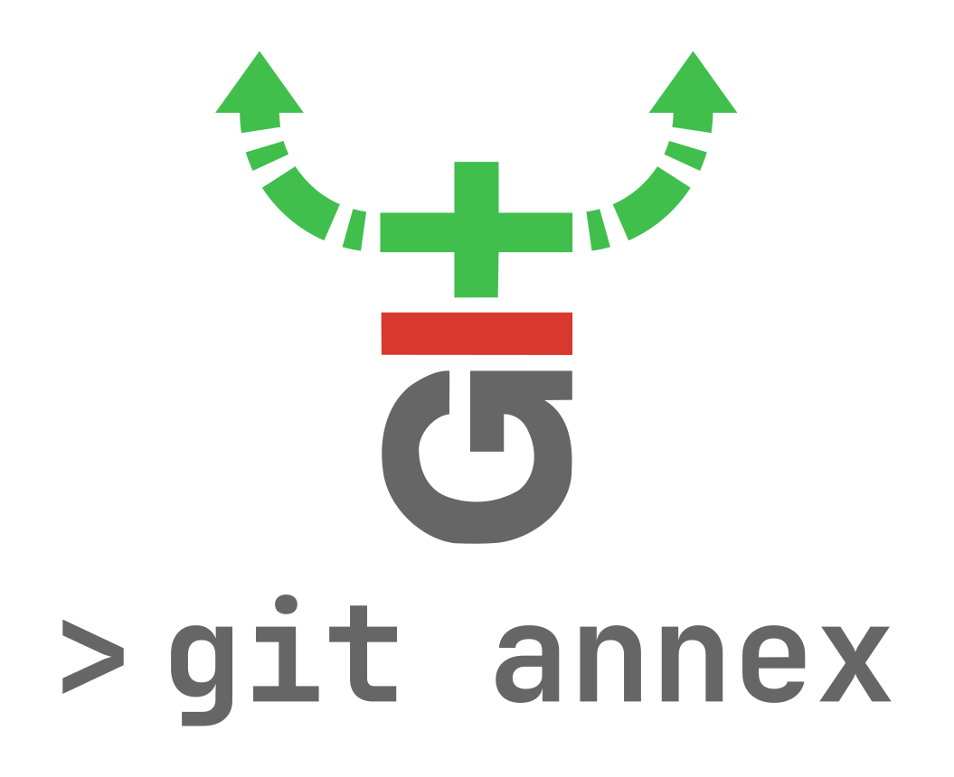


Tech Rundown & Summary
Operating System ⇒ Ubuntu Server
Infrastructure ⇒ Raspberry Pi 5 cluster
Containerization & Orchestration ⇒ K3s
Replication ⇒ Longhorn
Version Tracking ⇒ Git
LFH & Encryption ⇒ Git annex
User Auth & Database ⇒ Supabase
Goal: Build a self-hosted, low-cost submission system on a Raspberry Pi cluster that supports very large, encrypted student projects
Notes:
CONNER - mention summer HS-level game-dev course??

Slide 13

THANK YOU! 🎆 Questions? –Team 12

